Slide 1
Memory and Storage
Group Members
Elshauna Dixon, Wakar Molar, Marjorie Sinclair, Chelese Hinds, David Chung

Slide 2
Table of Contents
Memory and Storage
Types of Memory
Types of Storage
Primary Storage vs. Secondary Storage
What is Hard Drive ?
Overview: Large Hard Disk Drives

Slide 3
Table of Contents
Overview of Flash Memory
What is Flash Memory ?
Highlights of Flash Memory
Overview of USB Flash Drive
What is USB Flash Drive ?

Slide 4
Table of Contents
Highlights of a USB Flash Drive
Overview of ISCSI
What is ISCSI ?
Highlights of ISCSI

Slide 5
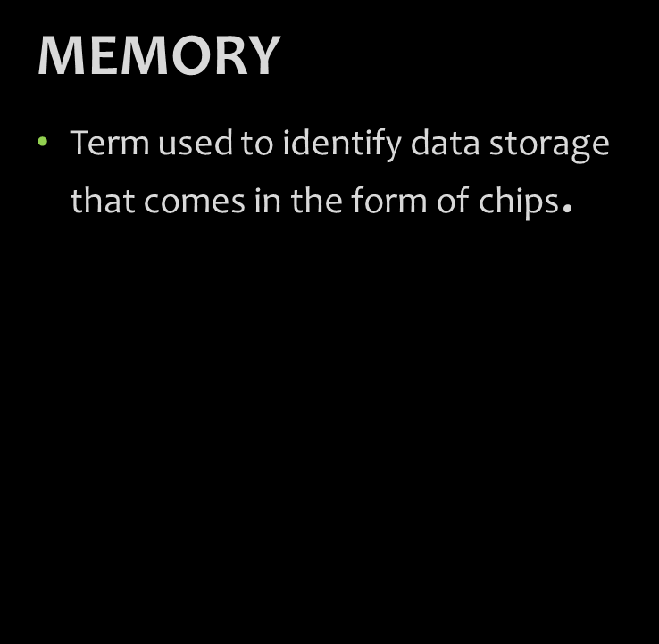
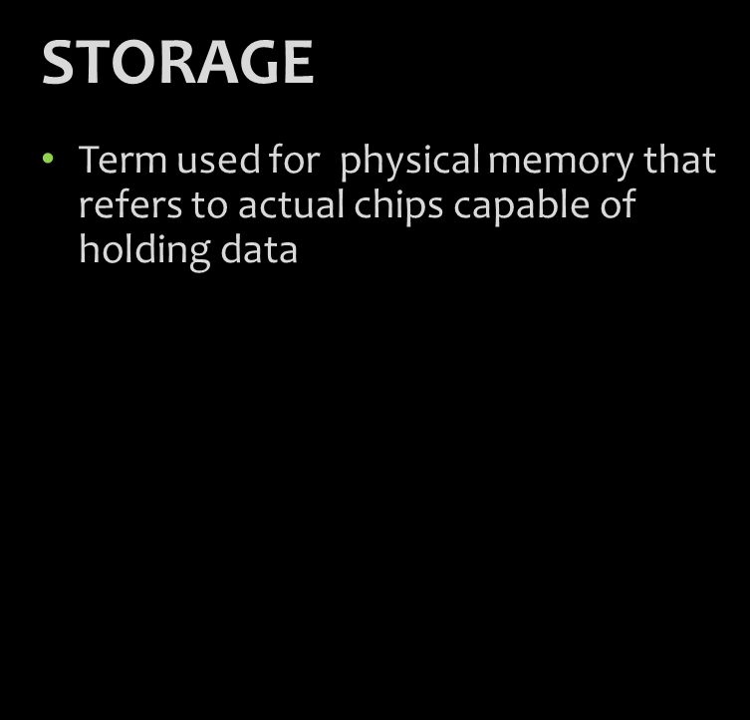
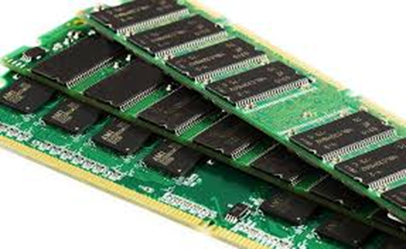
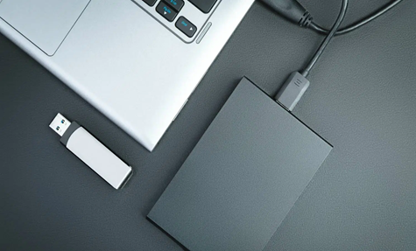
Memory and Storage

Slide 6
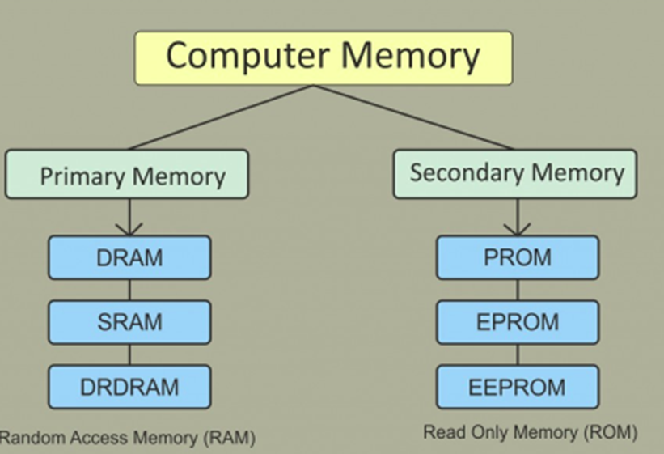
Types of Memory

Slide 7
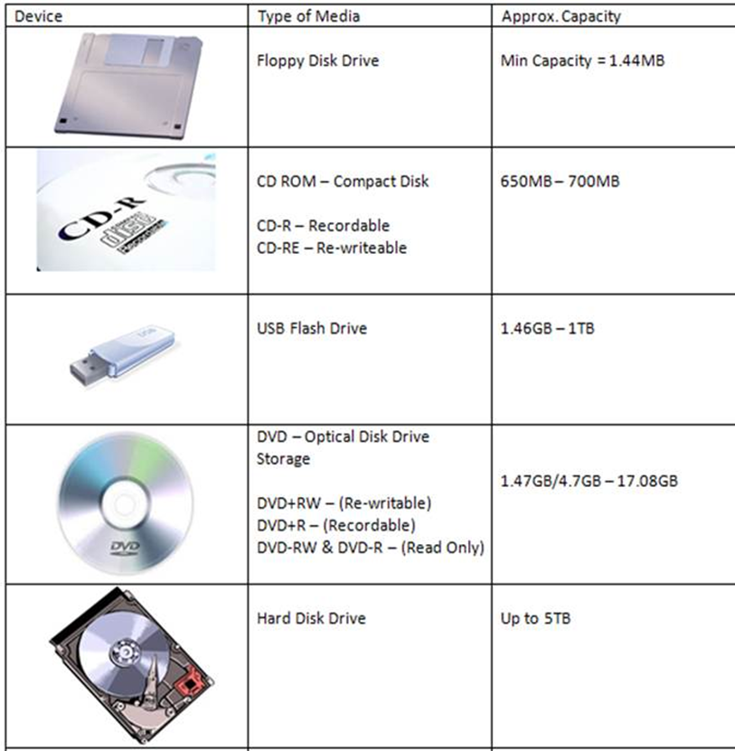
Types of Storage

Slide 8
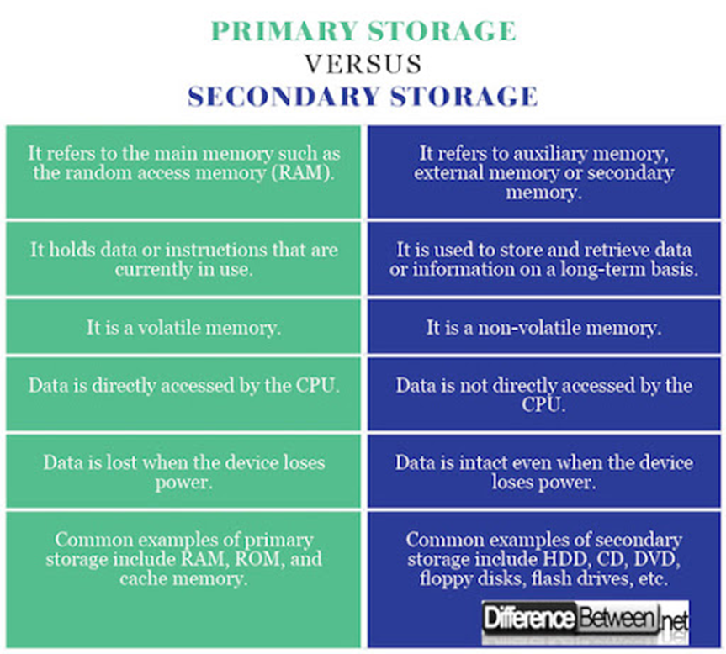
Primary Storage vs. Secondary Storage

Slide 9
What is a Hard Drive?
Notes:
A hard disk drive (sometimes abbreviated as a hard drive, HD, or HDD) is a non-volatile data storage device. It is usually installed internally in a computer, attached directly to the disk controller of the computer's motherboard. It contains one or more platters, housed inside of an air-sealed casing. Data is written to the platters using a magnetic head, which moves rapidly over them as they spin.

Slide 10
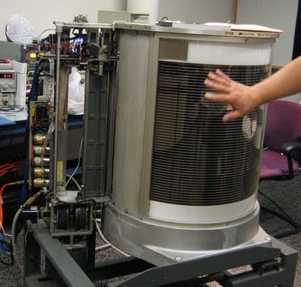
Overview: Large Hard Disk Drives (HDDs) 1950s-1970s:
1956: First HDD invented by IBM.
Name: IBM 350
Actual Size: two refrigerators
Weight: a ton
Storage Size: 5 MB

Slide 11
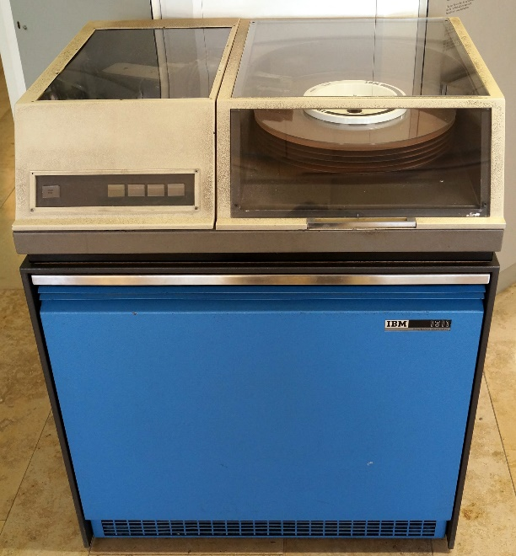
Overview: Large Hard Disk Drives (HDDs) 1950s-1970s Cont’d
1963: IBM 1311
First removable hard drive
Contained 6 disks
Storage Size: 2.6 MB

Slide 12
Overview: Large Hard Disk Drives (HDDs) 1950s-1970s Cont’d
1964: IBM 2311
First standardized disk
1970
Error Correction was introduced.
1973: IBM Winchester Drive
3 Removable sealed data modules
Notes:
1964: Used across multiple versions of the System/360 computer.
Error correction is the process of detecting errors in transmitted messages and reconstructing the original error-free data

Slide 13
Overview: Large Hard Disk Drives (HDDs) 1979s Cont’d
1979: IBM Piccolo Drive
Storage: 64MB on eight disks
1979: IBM 3370
First to use thin film heads.

Slide 14
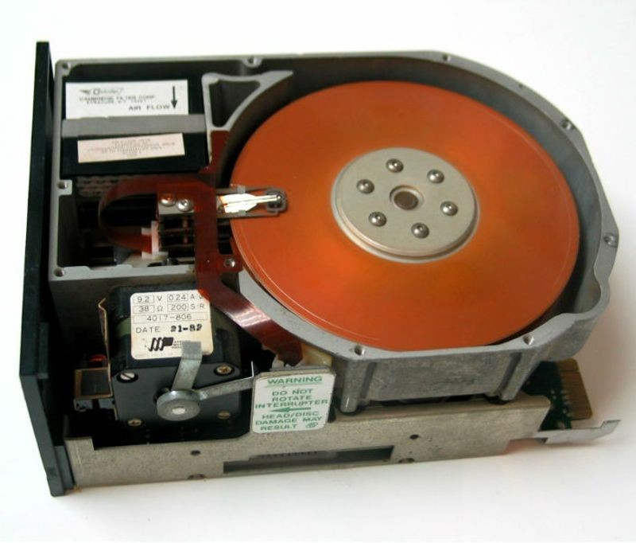
Overview: Large Hard Disk Drives (HDDs) 1980s Cont’d
1980: IBM 3380
First gigabyte-capacity disk drive
Storage: 2.5GB
Weight: 500 pounds
1980 : Seagate
First 5.25 inch hard drive
Storage: 5mb
1983 : Rodime
First 3.5 inch
Storage: 10mb
2 platters

Slide 15
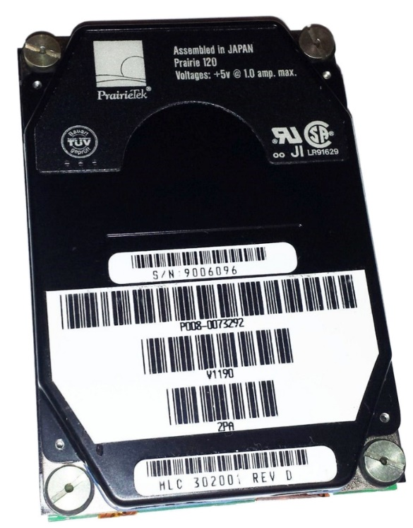
Overview: Large Hard Disk Drives (HDDs) 1980s Cont’d
1988: PrairieTek
First 2.5-inch hard drive
Designed for Notebook Computers
Storage 20mb
2 platters

Slide 16
Overview: Large Hard Disk Drives (HDDs) 1990s Cont’d
1991: IBM 0663 Corsair drive
First hard drive to use magneto resistive heads
Storage: 1GB
Eight disks
1991: Integra Peripherals
1.8-inch disk
1992: HP Kittyhawk
1.3-inch hard drive

Slide 17
Overview: Large Hard Disk Drives (HDDs) 1990s Cont’d
1997: IBM Titan
First hard drive to use giant magneto resistive (GMR) heads.
3.5-inch disk drive
Storage 16.8GB
1998: IBM Microdrive
Storage 340MB
1-inch disk platter

Slide 18
Overview: Large Hard Disk Drives (HDDs) 2000s Cont’d
2003: Seagate
First serial ATA drive
2005: Hitachi
First 500GB drive
2007:Hitachi
First terabyte drive
2010
First 3TB hard drives

Slide 19
Overview of Flash Memory
Notes:
Flash memory was invented in the early 1980s by Japanese engineer Masuoka Fujio, who was then working at the Toshiba Corporation and who was searching for a technology that would replace existing data-storage media such as magnetic tapes, floppy disks, and dynamic random-access memory (DRAM) chips. The name flash was coined by Ariizumi Shoji, a coworker of Masuoka, who said the process of memory erasure, which can erase all the data on an entire chip at one time, was like a camera’s flash.

Slide 20
What is Flash Memory?
Flash memory is a non-volatile memory chip used for storage and for transferring data between a personal computer (PC) and digital devices. It has the ability to be electronically reprogrammed and erased. It is often found in USB flash drives, MP3 players, digital cameras and solid-state drives.

Slide 21
Highlights of Flash Memory
It saves data when power is OFF. It is non-volatile and hence preserve state without any power.
Large and increased capacity
High transferring speed, hence it has faster read and write compare to traditional hard disk drives.
It does not have any moving parts larger than electrons.

Slide 22
Highlights of Flash Memory cont’d.
Small size, portability
Low power consumption than traditional hard disk drives
Work more quietly than physical hard drive
Cheaper compare to traditional drives in small storage capacities.

Slide 23
Overview of USB Flash Drive
USB 1.0 was introduced in 1995 by a working group of computer companies including Intel, Compaq, Microsoft and IBM. Their intent was to standardize the numerous specialized connectors PCs had at the time and to develop a basic device-connection protocol. The first USB product was released in 1996, and by 1998 the standard had been widely adopted. In 2000 the USB 2.0 standard was released.

Slide 24
What is USB Flash Drive?
A USB flash drive is a data storage device that includes flash memory with an integrated USB interface. It is typically removable, rewritable and much smaller than an optical disc.

Slide 25
Highlights of USB Flash Drive
Affordability
Security
Ease of Use
Speed and Versatility

Slide 26
What is ISCSI
ISCSI stands for Internet Small Computer Systems Interface. iSCSI is a transport layer protocol that works on top of the Transport Control Protocol (TCP). It enables block-level SCSI data transport between the iSCSI initiator and the storage target over TCP/IP networks. iSCSI supports encrypting the network packets, and decrypts upon arrival at the target.

Slide 27
Overview of ISCSI
It provides block-level access to storage devices by carrying SCSI commands over a TCP/IP network. iSCSI is used to facilitate data transfers over intranets and to manage storage over long distances. iSCSI was pioneered by IBM and Cisco in 1998 and submitted as a draft standard in March 2000.

Slide 28
Highlights of ISCSI
Increased storage utilization and manageability adds up to reducing the total cost of operation.
It lowers initial and hardware acquisition costs as it utilizes same standardized, inexpensive Ethernet equipment as a local area network (LAN).
No cost of training IT staff as it uses familiar TCP/IP technology and doesn't require expert personnel to install, configure, and manage the networks unlike Fiber Channel.
IP is a universal and non-proprietary technology used globally for the past 30 years. Hence, various network storage equipment's from different vendors can work together seamlessly.
As an IP-based protocol, iSCSI takes advantage of the interoperability benefits of TCP/IP and Ethernet.

Slide 29
Reference
https://www.rfwireless-world.com/Terminology/Advantages-and-Disadvantages-of-Flash-Memory.html
https://www.techopedia.com/definition/24481/flash-memory
https://www.cybrary.it/blog/2018/05/pros-and-cons-of-usb-flash-drives/
https://en.wikipedia.org/wiki/USB_flash_drive
https://www.enterprisestorageforum.com/storage-hardware/iscsi.html
https://thinkcomputers.org/the-history-of-the-hard-drive/
https://www.computerhope.com/jargon/h/harddriv.htm
https://www.britannica.com/technology/flash-memory
https://www.techwalla.com/articles/the-history-of-usb-flash-drives
https://en.wikipedia.org/wiki/ISCSI

